Slide 1
Neural Networks: Combining Neurons
Lecture 06

Slide 2
Contents
Motivation of Neural Networks
Forward Propagation
Implementation of XOR with Neural Networks

Slide 3
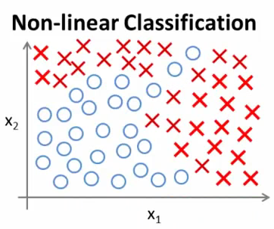

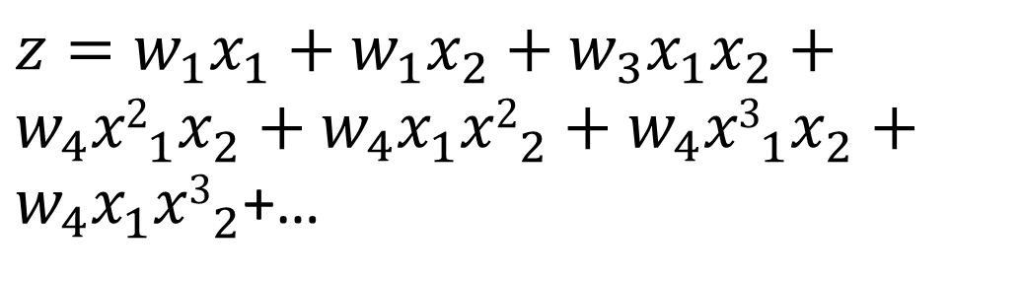
Motivation: Drawback of Simple Neuron
$z=w_{1}x_{1}+w_{1}x_{2}+w_{3}x_{1}x_{2}+w_{4}{x2}_{1}^{}x_{2}^{}+w_{4}x_{1}^{}{x2}_{2}^{}+w_{4}{x3}_{1}^{}x_{2}^{}+w_{4}x_{1}^{}{x3}_{2}^{}$+…
$$a= σ(z)$$
Notes:
Only works well when you have two features. But many ML problems have large no. of features.

Slide 4
Motivation: Drawback of Simple Neuron
If n =100
x1² +x1x2+ x1x3+ ...+ x1x100 + x2² + x2x3 + ....
≈5000
O(n²)
$z=w_{1}x_{1}+w_{1}x_{2}+w_{3}x_{1}x_{2}+w_{4}{x2}_{1}^{}x_{2}^{}+w_{4}x_{1}^{}{x2}_{2}^{}+w_{4}{x3}_{1}^{}x_{2}^{}+w_{4}x_{1}^{}{x3}_{2}^{}$+…
$$a= σ(z)$$
Notes:
Only works well when you have two features. But many ML problems have large no. of features.

Slide 5
Motivation: Drawback of Simple Neuron
If n =100
x1² +x1x2+ x1x3+ ...+ x1x100 + x2² + x2x3 + ....
≈5000
O(n²)
x1³ +x1x2x3+ x1x2x4+ ...+ x1x2x100 + x2³ + x2x3x4 + ....
≈170000
O(n³)
$z=w_{1}x_{1}+w_{1}x_{2}+w_{3}x_{1}x_{2}+w_{4}{x2}_{1}^{}x_{2}^{}+w_{4}x_{1}^{}{x2}_{2}^{}+w_{4}{x3}_{1}^{}x_{2}^{}+w_{4}x_{1}^{}{x3}_{2}^{}$+…
$$a= σ(z)$$
Notes:
Only works well when you have two features. But many ML problems have large no. of features.

Slide 6

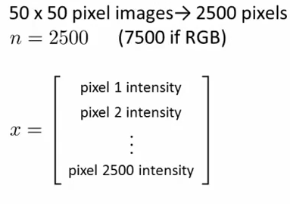





Computer Vision: Car Detection
$${x }_{1}$$
$$z$$
$$a$$
$$a=\hat{y }$$

Slide 7
Computer Vision: Car Detection
$${x }_{1}$$
$$z$$
$$a$$
$$a=\hat{y }$$
Practically Infeasible

Slide 8
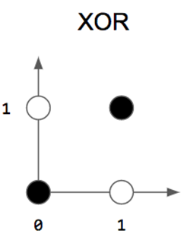
Motivation: Divide and Conquer
Implementing XOR with Neuron

Slide 9
Motivation: Divide and Conquer
Implementing XOR with Neuron

Slide 10
Motivation: Divide and Conquer
Implementing XOR with Neuron
Neuron# 2
Neuron# 1

Slide 11









Multilayered Neurons
Neuron# 1
$$w_{11}$$
$$x_{1}$$
$$w_{11}$$
$$w_{12}$$
$$\hat{y}$$
$$w_{21}$$
$$x_{2}$$
$$w_{22}$$
$$w_{21}$$
Neuron# 2
Neuron# 3

Slide 12
Multilayered Neurons
Neuron# 1
$$w_{11}$$
$$x_{1}$$
$$w_{11}$$
$$w_{12}$$
$$\hat{y}$$
$$w_{21}$$
$$x_{2}$$
$$w_{22}$$
$$w_{21}$$
Neuron# 2
Neuron# 3

Slide 13
Multilayered Neurons
Neuron# 1
$$w_{11}$$
$$x_{1}$$
$$w_{11}$$
$$w_{12}$$
$$\hat{y}$$
$$w_{21}$$
$$x_{2}$$
$$w_{22}$$
$$w_{21}$$
Neuron# 2
Neuron# 3
Input layer

Slide 14
Multilayered Neurons
Neuron# 1
$$w_{11}$$
$$x_{1}$$
$$w_{11}$$
$$w_{12}$$
$$\hat{y}$$
$$w_{21}$$
$$x_{2}$$
$$w_{22}$$
$$w_{21}$$
Neuron# 2
Neuron# 3
Hidden layer

Slide 15
Multilayered Neurons
Neuron# 1
$$w_{11}$$
$$x_{1}$$
$$w_{11}$$
$$w_{12}$$
$$\hat{y}$$
$$w_{21}$$
$$x_{2}$$
$$w_{22}$$
$$w_{21}$$
Neuron# 2
Neuron# 3
Output layer

Slide 16
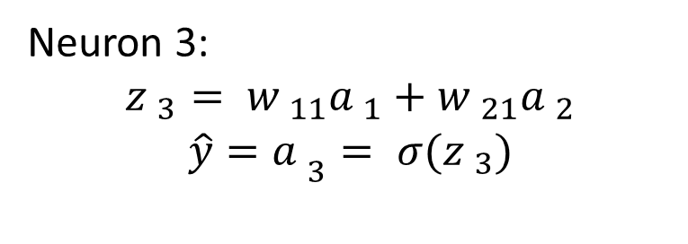
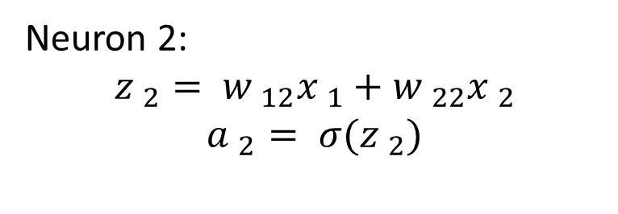
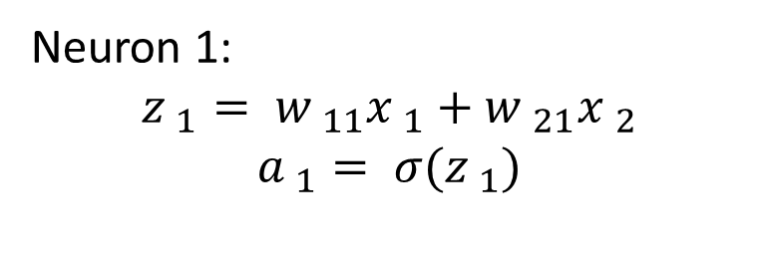
Multilayered Neurons
Neuron 1:
$${z }_{1}= {w }_{11}{x }_{1}+{w }_{21}{x }_{2}$$
$${a }_{1}= σ({z }_{1})$$
$$w_{11}$$
$$x_{1}$$
$$w_{11}$$
$$w_{12}$$
$$\hat{y}$$
$$w_{21}$$
$$x_{2}$$
$$w_{22}$$
$$w_{21}$$
Neuron 2:
$${z }_{2}= {w }_{12}{x }_{1}+{w }_{22}{x }_{2}$$
$${a }_{2}= σ({z }_{2})$$
Neuron 3:
$${z }_{3}= {w }_{11}{a }_{1}+{w }_{21}{a }_{2}$$
$${\hat{y}=a }_{3}= σ({z }_{3})$$

Slide 17
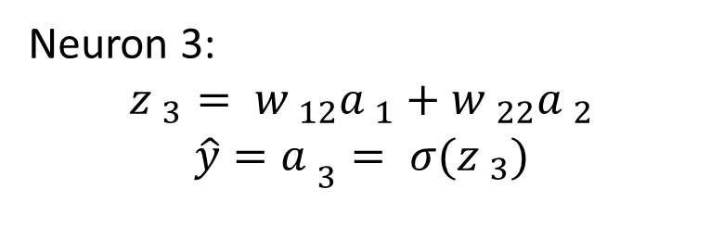
Multilayered Neurons
Neuron 1:
$${z }_{1}= {w }_{11}{x }_{1}+{w }_{21}{x }_{2}$$
$${a }_{1}= σ({z }_{1})$$
$$w_{11}$$
$$x_{1}$$
$$w_{11}$$
$$w_{12}$$
$$\hat{y}$$
$$w_{21}$$
$$x_{2}$$
$$w_{22}$$
$$w_{21}$$
Neuron 2:
$${z }_{2}= {w }_{12}{x }_{1}+{w }_{22}{x }_{2}$$
$${a }_{2}= σ({z }_{2})$$
Neuron 3:
$${z }_{3}= {w }_{12}{a }_{1}+{w }_{22}{a }_{2}$$
$${\hat{y}=a }_{3}= σ({z }_{3})$$
The process of passing input and obtaining output is known as forward propagation

Slide 18
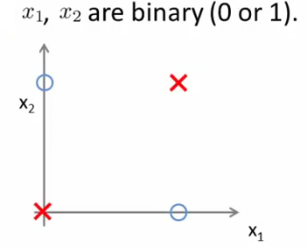
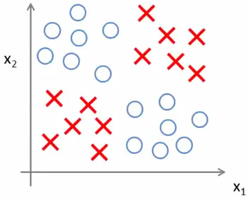
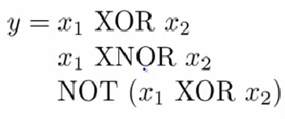
Implementing XOR/XNOR with Neural Networks

Slide 19

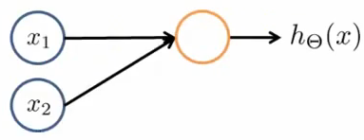
Simple Example: AND

Slide 20
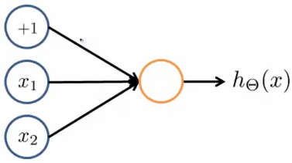
Simple Example: AND
Notes:
-30,+20,+20

Slide 21
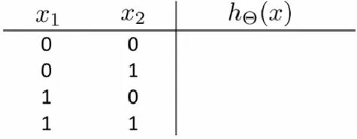
Simple Example: AND
Notes:
-30,+20,+20

Slide 22
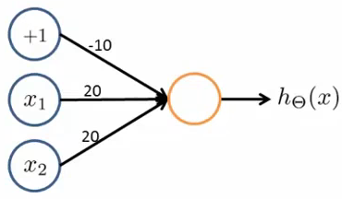
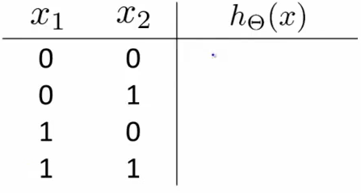
Example: OR Function

Slide 23
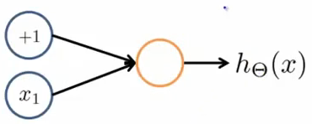
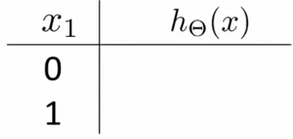

Example: Negation Function
Notes:
General idea: put negative weight in front of variable to negate

Slide 24

Example: Negation Function
Design a Network to model:
Notes:
General idea: put negative weight in front of variable to negate

Slide 25
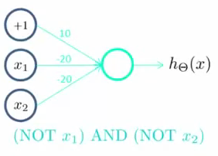
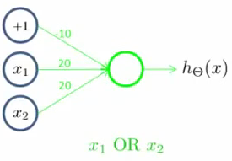
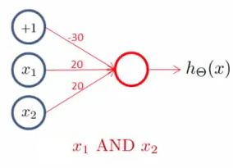
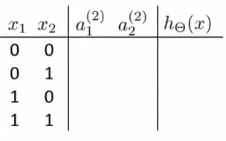

x1 XNOR x2

Slide 26
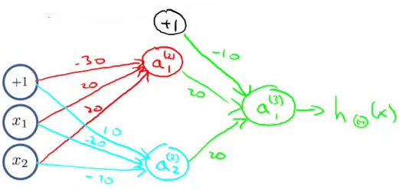
x1 XNOR x2

